Slide 1

Hotel Booking Prediction
Team 9 (سوبيا الرحماني)

Slide 2
CMPS451 – Big Data
Team Members
Ahmed Emad Reda | 1190180 | Hla Hany Mohamed | 1190344
Yomna Osama Hussein | 1190203 | Youssef Mohamed Mahmoud | 1190202

Slide 3
Problem Description
Hotel Cancellation Prediction with Machine Learning
Actionable insights for hotels
Predict cancellations to:
Offer discounts and prevent revenue loss
Adjust staffing and optimize costs

Slide 4
Project Pipeline
Data Loading
EDA
Preprocessing
Feature Engineering
Model Development

Slide 5
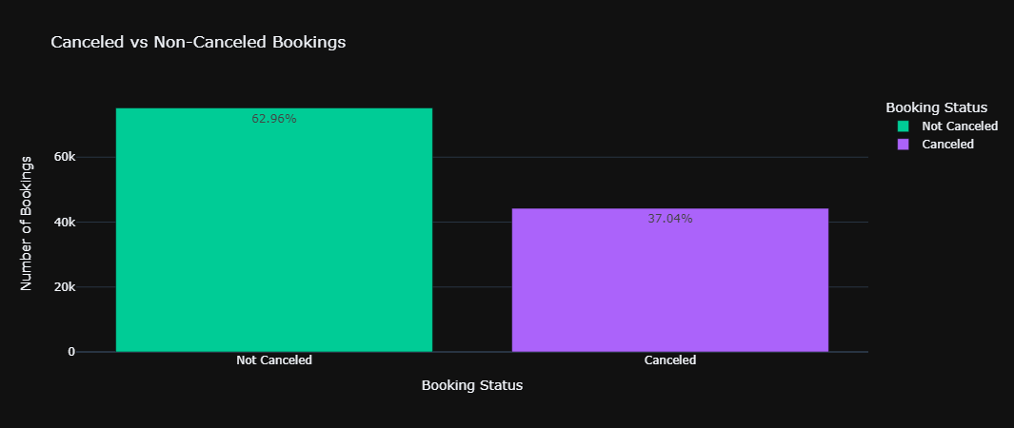
📊 Exploratory Data Analysis
🕵️‍♂️ Cancelled vs. Not Canceled:

Slide 6
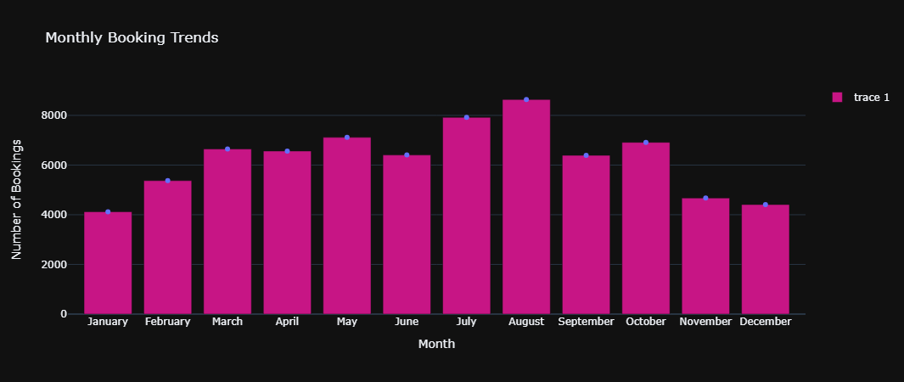
📊 Exploratory Data Analysis
🕵️‍♂️ First Observation:
The majority of reservations occur in the months of July and August, while the fewest bookings are made at the start and close of the year.

Slide 7
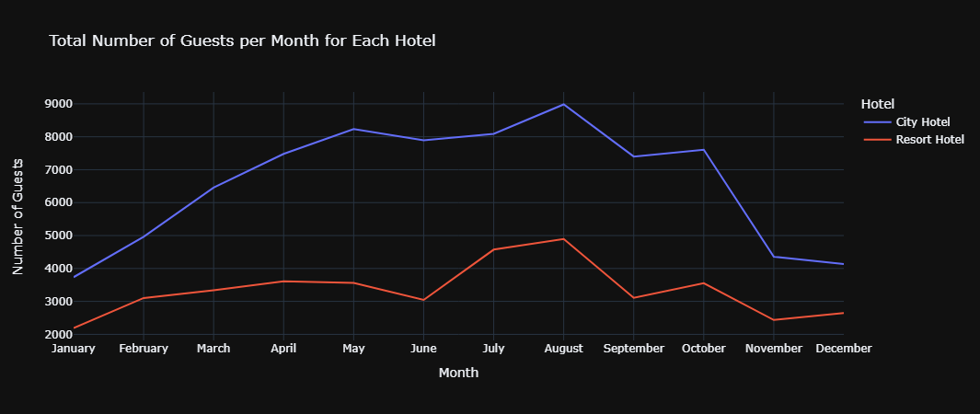
📊 Exploratory Data Analysis
🕵️‍♂️ Second Observation:
City Hotels have more monthly bookings and overall bookings than Resort Hotels.
Both hotels have the fewest guests during the winter.

Slide 8
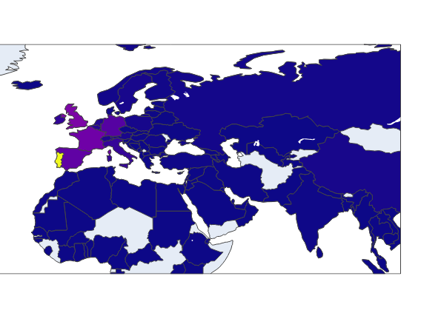
Exploratory Data Analysis
🕵️‍♂️ Third Observation:
The number of guests from Portugal is significantly higher than the other countries.
Portugal, Great Britain and France account for 50% of the guests.

Slide 9
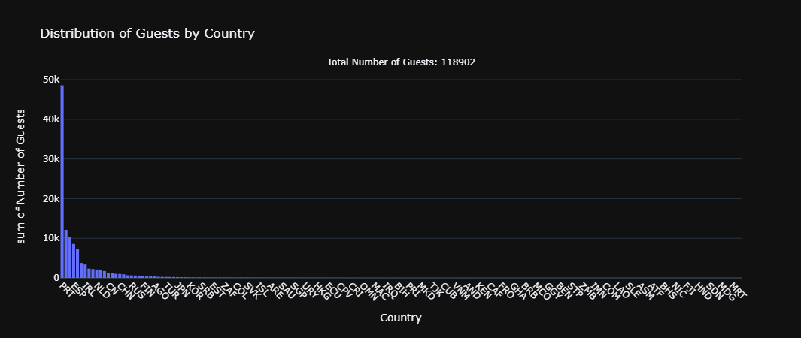
Exploratory Data Analysis
🕵️‍♂️ Third Observation:
The number of guests from Portugal is significantly higher than the other countries.
Portugal, Great Britain and France account for 50% of the guests.

Slide 10
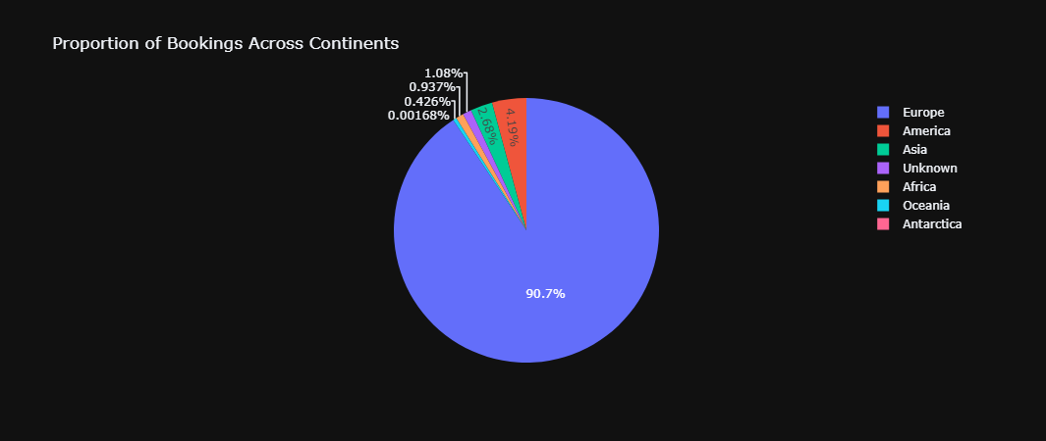
📊 Exploratory Data Analysis
🕵️‍♂️ Third Observation:
The number of guests from Portugal is significantly higher than the other countries.
Portugal, Great Britain and France account for 50% of the guests.

Slide 11
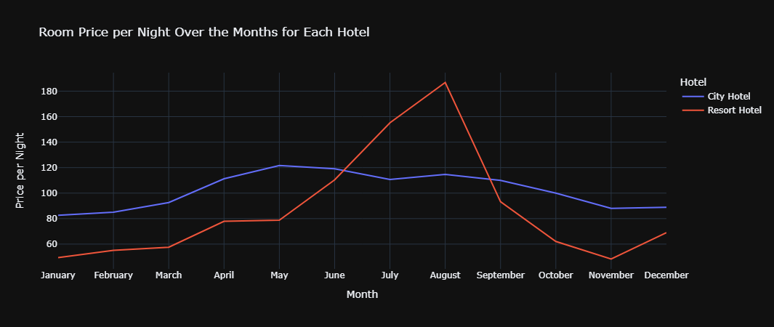
📊 Exploratory Data Analysis
🕵️‍♂️ Fourth Observation:
This plot clearly shows that prices in the Resort Hotel are much higher during the summer and prices of city hotel varies less.

Slide 12
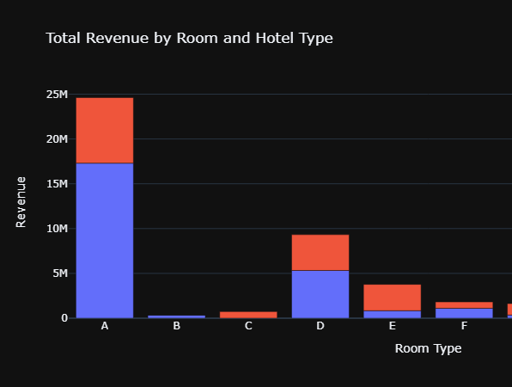
Exploratory Data Analysis
🕵️‍♂️ Fifth Observation:
City hotels generate higher revenues compared to resort hotels across all room types.
Room type A are the most profitable for both city and resort hotels.

Slide 13
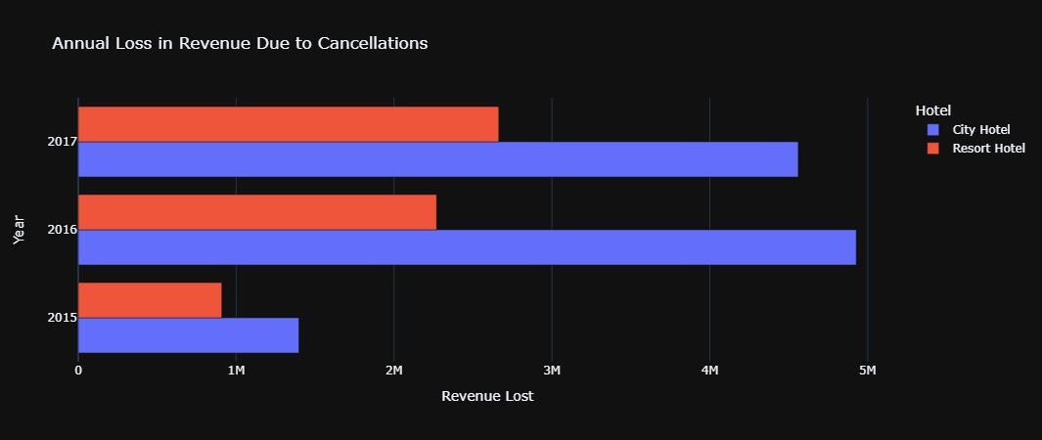
📊 Exploratory Data Analysis
🕵️‍♂️ Sixth Observation:
There is a great loss over the years in the revenue due to cancellations for both city and resort hotels, but it is more obvious in the city hotels significantly.

Slide 14
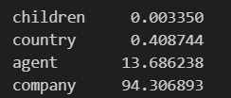
⚙️ Preprocessing
⚠️ Handling missing values
Get percentage of missing values in each column.
Drop the columns ‘agent and company’.
Drop the rows with missing values in the column 'country’.

Slide 15
🛠️ Feature Engineering
🔒 Preventing Data Leakage
The `reservation_status` and `reservation_status_date` columns should be dropped because they provide information about when the booking was canceled or when the customer checked out of the hotel.
🤖 Encoding the categorical columns and discretizing the numerical columns
Encoding Categorical Columns
Discretizing Numerical Columns

Slide 16
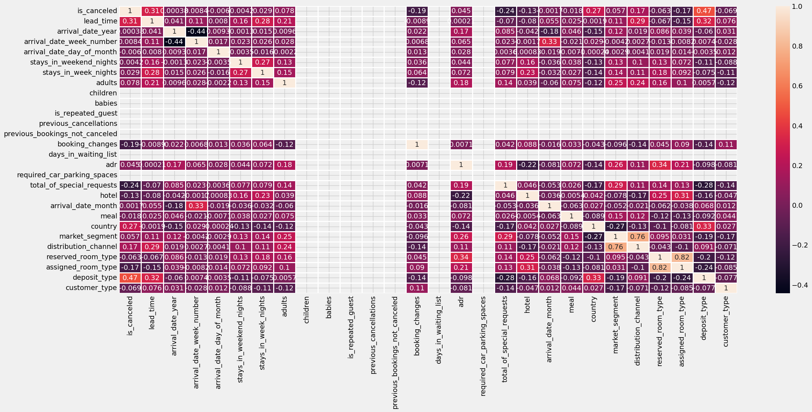
📈 Feature Selection
Analyzing the correlation between the target variable and the independent features:

Slide 17
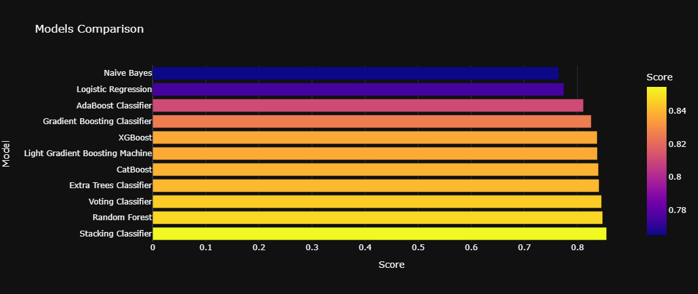
🚀 Model Development

Slide 18
🙁 Unsuccessful Trials
ANOVA:
Assumes continuous target variables and may not provide meaningful insights when applied to binary outcomes.
Inappropriate for capturing the relationship between categorical predictors and binary targets, leading to ineffective feature selection.

Slide 19
Naïve Bayes Classifier
Prior Probabilities:
Mapper:
Output: [(c0, 1), (c1, 1), (c0, 1), (c0, 1), (c1, 1)]
Reducer: (by key)
Output: Output: [(c0, 3), (c1, 2)]
Prior probability: {0.0: 0.629, 1.0: 0.3708}

Slide 20
Naïve Bayes Classifier
Likelihood Probabilities:
Mapper: [(c0, (f1, v1, 5)), (c0, (f1, v2, 10)), (c1, (f1, v1, 2))]
Reducer1: [(c0, (f1, v1, 50)), (c0, (f1, v2, 45)), (c1, (f1, v1, 36))]
Reducer2: [(c0, (f1, v1, 50, 100)), (c0, (f1, v2, 45, 100)), (c1, (f1, v1, 36, 80))]
Reducer3: [(c0, (f1, v1, 50/100)), (c0, (f1, v2, 45/100)), (c1, (f1, v1, 36/80))]
Training Accuracy: 0.7757330104753382
Testing Accuracy: 0.7701604413189035

Slide 21

Thank you!

